Slide 1











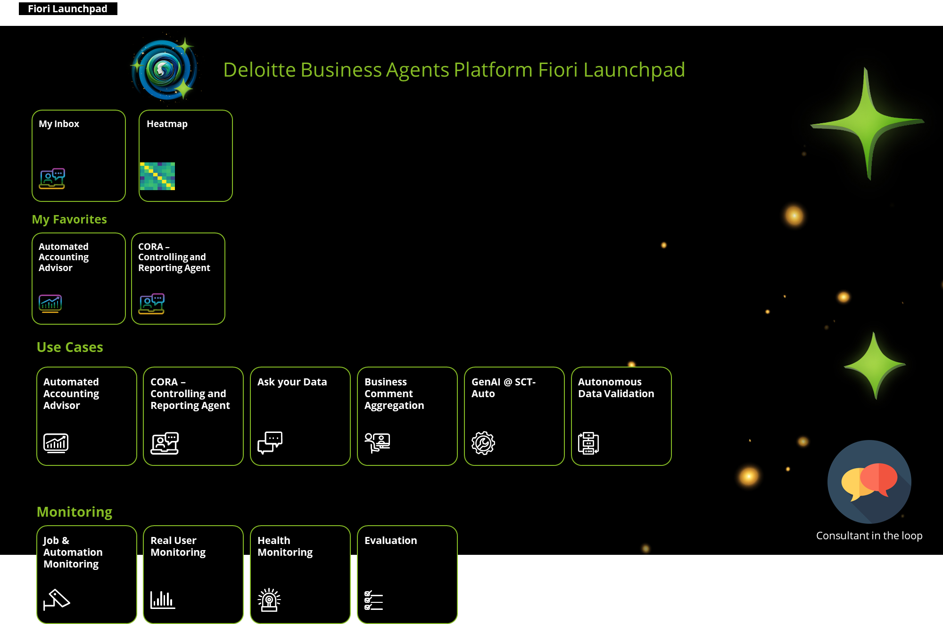
When you click on About BAP, it will stay in the same page but show the description of BAP below the overview (please see slide 2)
My Site
Chat with a consultant
Deloitte Business Agents Platform
Get ahead of the AI curve - One-stop access into the world of AI for SAP
About BAP
Agents
Description of all the available agents
Process Map
Learn how agents could help you
Agent Launchpad
Use your agents
Consultant in the Loop
Smarter Decisions. Human Support.
Joule
BAP & Joule are working together
Zora
Learn about Deloitte Zora
Click here and it will lead you to the following 6 sub pages
Get ahead of the AI curve
1
One-Stop AI Agent Access for all relevant SAP AI topics
2
Flexible customer focused platform makes it easy to develop new SAP agents in a established framework
3
100% SAP technology allows easy integration and implementation into your IT landscape while relying on established security standards and access rights
4
Measure, monitor, orchestrate and scale your AI Agent solutions and deliver insights on returns, success and adoption to prioritize further investments
5
Regulatory compliance with EU’s AI ACT and US National AI Initiative ACT and internal regulations for your used LLMs and Agents
Powered by
Experience the power of AI from one centralized SAP based platform and leverage AI for your sustainable success.
Notes:
Hourly rate

Slide 2
Agents
Description of all the available agents
Process Map
Learn how agents could help you
Agent Launchpad
Use your agents
Consultant in the Loop
Smarter Decisions. Human Support.
Joule
BAP & Joule are working together
Zora
Learn about Deloitte Zora
The start page view when clicking on „About BAP“, it will show you the part of BAP description, while the 6 sub page tiles stay above
Get ahead of the AI curve
1
One-Stop AI Agent Access for all relevant SAP AI topics
2
Flexible customer focused platform makes it easy to develop new SAP agents in a established framework based on agent framework
About Base Agents
3
100% SAP technology allows easy integration and implementation into your IT landscape while relying on established security standards and access rights
4
Measure, monitor, orchestrate and scale your AI Agent solutions and deliver insights on returns, success and adoption to prioritize further investments
5
Regulatory compliance with EU’s AI ACT and US National AI Initiative ACT and internal regulations for your used LLMs and Agents
Powered by
Experience the power of AI from one centralized SAP based platform and leverage AI for your sustainable success.
Notes:
Hourly rate

Slide 3
My Site
Chat with a consultant
Business Agents – Your new digital workforce force
Available agents in your network:
GenAI name | Description
Automated Accounting Advisor | The tool uses company-specific accounting details and GenAI to provide fast posting proposals to accountants, while keeping the “human in the loop” and update the ERP system automatically
Invoice Posting Assistant | Invoice management simplified to automate invoice reading and posting using Amazon Textract & SAP
Autonomous Data Validation | This tool accelerates data validation by using GenAI technology and help to find errors, understand big data sets and support decision making without the need of advanced technology knowledge
Ask your Data | User friendly chat interface, which translates natural language into SQL statement and executes it to display the results
Spare Parts Recognition | Advance image recognition to register and identify personal & spare parts to optimize service processes
Business Comment Aggregation | Reading comments from SAC data models and provide a structured summary, highlight important facts and extract action points
SkillBridge | Perform skill gap analysis and recommendations to evaluate skills employees currently possess, the skills required for their roles and recommendations on how to bridge the gap based on company’s data
Input regarding Agents description and mapping → „What“ team → Ralf needed

Slide 4
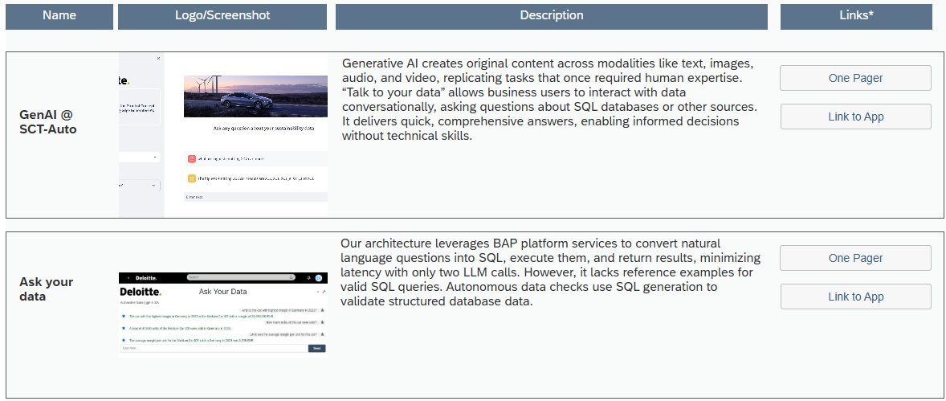
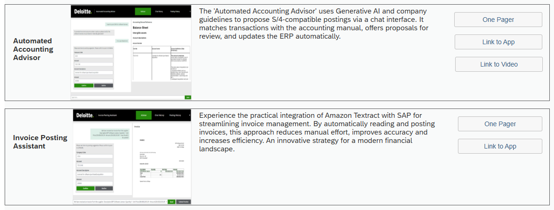
My Site
Chat with a consultant
Business Agents – Your new digital workforce force
Available agents in your network:
Automated Accounting Advisor
Invoice Posting Assistant
Autonomous Data Validation
Ask your Data
User friendly chat interface, which translates natural language into SQL statement and executes it to display the results
This tool accelerates data validation by using GenAI technology and help to find errors, understand big data sets and support decision making without the need of advanced technology knowledge
Invoice management simplified to automate invoice reading and posting using Amazon Textract & SAP
The tool uses company-specific accounting details and GenAI to provide fast posting proposals to accountants, while keeping the “human in the loop” and update the ERP system automatically
Spare Parts Recognition
Business Comment Aggregation
SkillBridge
XXX
Perform skill gap analysis and recommendations to evaluate skills employees currently possess, the skills required for their roles and recommendations on how to bridge the gap based on company’s data
Reading comments from SAC data models and provide a structured summary, highlight important facts and extract action points
Advance image recognition to register and identify personal & spare parts to optimize service processes
Input regarding Agents description and mapping → „What“ team → Ralf needed

Slide 5



My Site
Chat with a consultant
Business Agents Platform Launchpad
My Inbox
Process Map
My Favorites
Automated Accounting Advisor
Controlling and Reporting Agent
Agents
Automated Accounting Advisor
CORA – Controlling and Reporting Agent
Ask your Data
Business Comment Aggregation
GenAI @ SCT-Auto
Autonomous Data Validation
Administration
LLM Management
Prompt composition
Data Management
Knowledge Ingestion
Access Management
Monitoring
Job & Automation Monitoring
Real User Monitoring
Health Monitoring
Evaluation
Notes:
Have to be fiori launchpad,

Slide 6
Excel to prepare
My Site
Chat with a consultant
SAP Process Map
Learn how agents could help you in your daily work based on SAP processes
When clicking on sub proceses, e.g. „Analytics & Reporting“, it will show the Name of Agent(s) within the process
If click on the process → it will lead to Fiori Launchpad
IDEA TO MARKET
SOURCE TO PAY
PLAN TO FULFILL
LEAD TO CASH
RECRUIT TO RETIRE
CROSS FUNCTION
Plan to Optimize
Products / Services
Plan to Optimize
Sourcing & Procurement
Plan to Optimize
Fulfillment
Plan to Optimize
Marketing & Sales
Plan to Optimize
Workforce
Analytics & Reporting
Idea to Requirements
Source to Contract
Make to Inspect
Market to Lead
Recruit to Onboard
Sustainability
Design to Release
Plan to Optimize
Fulfillment
Procure to Receipt
Opportunity to Quote
Develop to Grow
Integration Management
Products / Services to Market
Procure to Receipt
Deliver Product to Fulfill
Order to Fulfill
Reward to Retain
Master Data Management
Excel of mapping:
Link
(Andreas & Ralf working on the mapping)
Manage Products / Services
Request to Resolution
Deliver Service to Fulfill
Request to Service
Manage Workforce & Retirement
Invoice to Pay
Manage Fulfillment
Invoice to Cash
Manage Suppliers / Collaboration
Active Agents
Inactive Agents
SAP Embedded-AI Agent

Slide 7

Introducing: Consultant in the Loop Smarter Decisions. Human Support. Seamless Experience.
My Site
Chat with a consultant
You don’t have to navigate AI alone. With Consultant in the Loop, you get the best of both worlds: the power of automation with the insight and reassurance of real human expertise.
Why It Matters to You
Stay in Control
AI is fast, but you’re still the decision-maker. Our consultants step in at critical moments to validate decisions, offer guidance, and ensure everything aligns with your goals.
Navigate Complexity with Confidence
Got a tough challenge? Complex process? No worries. We’re here with expert support—built into your workflow—ready to help when things get tricky.
Get More Value from AI
We're not just launching tools—we're building partnerships. Our consultants help turn insights into action, and actions into results.
💬 Ready to Explore? We'd love to show you how Consultant in the Loop can simplify your work, empower your team, and make AI truly work for you.
How It Works (In Simple Terms)
You interact with AI agents – fast, efficient answers and support
We stay touch– when stakes are high, our experts jump in
You get results – with more accuracy, less risk, and full confidence
Choose the Model That Fits You
Whether you want full-service support (Managed Service) or just need help as you go (T&M), we’ve got flexible options tailored to your needs.
Chat with a consultant

Slide 8


My Site
Chat with a consultant
Zora AI™ by Deloitte
Your new digital workforce that transforms business operations through autonomous intelligence
Zora AI™ by Deloitte represents the future of work—an advanced AI platform with ready-to-deploy intelligent agents that revolutionize how businesses operate. Unlike conventional automation tools, Zora AI agents think, learn, and execute complex business functions with remarkable speed and precision.
Our platform seamlessly integrates domain-specific intelligence with flexible technical architecture, allowing your business to deploy AI solutions that work alongside your human workforce—handling repetitive tasks, analyzing complex data, and generating valuable insights that drive growth and innovation.
Zora AI™ and Business Agents Platform
When Zora AI™ combines with our Business Agents platform for SAP, it creates a transformative ecosystem that redefines operational excellence. This powerful synergy enables:
Real-time decision support with contextual understanding
End-to-end process automation with human-like reasoning
Continuous learning from each interaction to improve outcomes
Transparent operations with detailed audit trails
Together, they deliver unprecedented value by augmenting human capabilities while maintaining governance and compliance standards essential for enterprise operations.

Slide 9
My Site
Chat with a consultant
CORA→ Ralf / Andreas
autonomous intelligence
eMail
Chat
Joule

Slide 10
My Site
Chat with a consultant
Atonomous Data, InttRalf / Andreas
autonomous intelligence

Slide 11
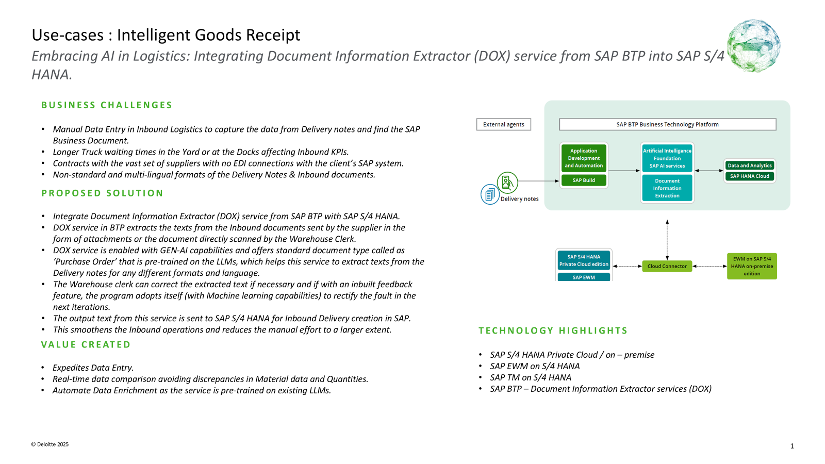
My Site
Chat with a consultant
Intteligence Good receipt → Ralf / Andreas
autonomous intelligence

Slide 12
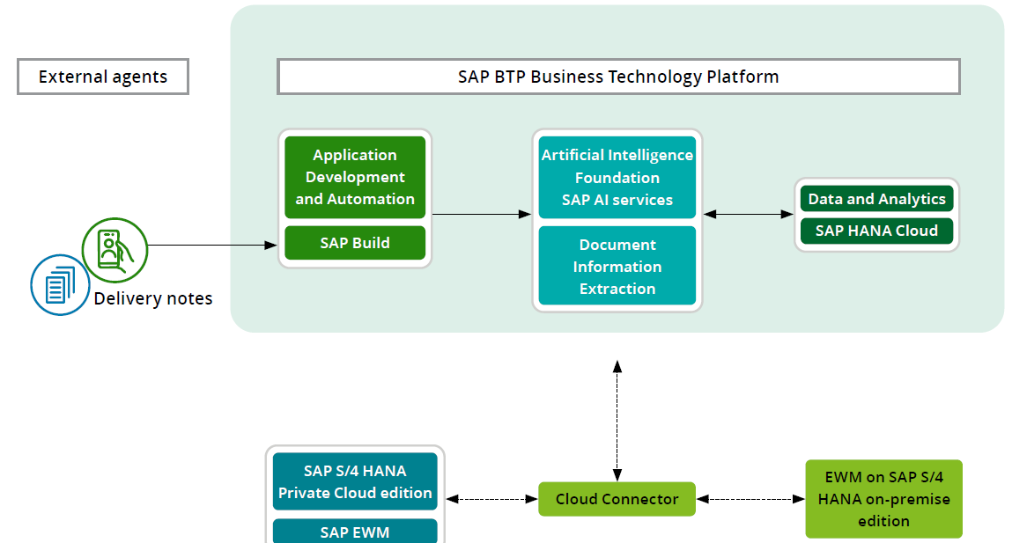
Use-cases : Intelligent Goods Receipt
Embracing AI in Logistics: Integrating Document Information Extractor (DOX) service from SAP BTP into SAP S/4 HANA.
BUSINESS CHALLENGES
Manual Data Entry in Inbound Logistics to capture the data from Delivery notes and find the SAP Business Document.
Longer Truck waiting times in the Yard or at the Docks affecting Inbound KPIs.
Contracts with the vast set of suppliers with no EDI connections with the client’s SAP system.
Non-standard and multi-lingual formats of the Delivery Notes & Inbound documents.
PROPOSED SOLUTION
Integrate Document Information Extractor (DOX) service from SAP BTP with SAP S/4 HANA.
DOX service in BTP extracts the texts from the Inbound documents sent by the supplier in the form of attachments or the document directly scanned by the Warehouse Clerk.
DOX service is enabled with GEN-AI capabilities and offers standard document type called as ‘Purchase Order’ that is pre-trained on the LLMs, which helps this service to extract texts from the Delivery notes for any different formats and language.
The Warehouse clerk can correct the extracted text if necessary and if with an inbuilt feedback feature, the program adopts itself (with Machine learning capabilities) to rectify the fault in the next iterations.
The output text from this service is sent to SAP S/4 HANA for Inbound Delivery creation in SAP.
This smoothens the Inbound operations and reduces the manual effort to a larger extent.
TECHNOLOGY HIGHLIGHTS
SAP S/4 HANA Private Cloud / on – premise
SAP EWM on S/4 HANA
SAP TM on S/4 HANA
SAP BTP – Document Information Extractor services (DOX)
VALUE CREATED
Expedites Data Entry.
Real-time data comparison avoiding discrepancies in Material data and Quantities.
Automate Data Enrichment as the service is pre-trained on existing LLMs.

Slide 13
My Site
Chat with a consultant
AAA→ Ralf / Andreas
autonomous intelligence

Slide 14

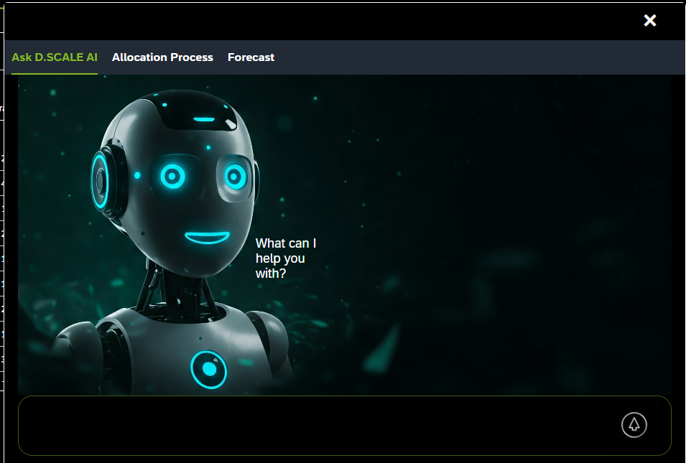
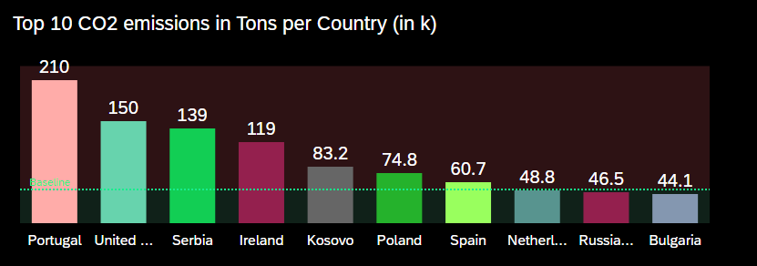
Use-cases : D.SCALE
Embracing AI in Logistics: Using AI and Predictions to Predict Carbon Emissions with SAP Analytics Cloud
BUSINESS CHALLENGES
Necessity to report NFRD (Non-Financial Reporting data) for every firm since 2014.
EU- mandated act CSRD for all the firms (listed or non-listed) to report their Sustainability and Climate impact related data.
To be legally compliant with the changing EU Regulations and be competent to their customers and Business partners.
PROPOSED SOLUTION
Identify important KPIs relevant for reporting the company’s Sustainability related data.
Leverage existing data from SAP EWM such as Packaging Waste, Electricity Consumption, Employee Safety through Resource Management and other data from the EWM Warehouse tasks
Leverage existing data from SAP TM such as CO2 emission and Fuel consumption factors from the different means of Transports used.
Use out of the box integration between SAP Analytics Cloud and SAP S/4 HANA.
Use in-build Predictive Analytics capabilities of SAP SAC to analyze, report the important KPIs such as CO2 emissions at different levels, such as Warehouse, Region or Country.
Comparison of the Warehouse sustainability parameters and prediction of the different emission factors in the next Quarter or month based on the input historic business data of SAP S/4 HANA.
TECHNOLOGY HIGHLIGHTS
SAP S/4 HANA Private Cloud / on – premise
SAP EWM on S/4 HANA
SAP TM on S/4 HANA
SAP SAC (Analytics Cloud)
VALUE CREATED
Makes the companies Compliant with the changing EU Regulations.
Assists the companies in determining the Product Carbon footprint in Logistics Processes.
Assist in reporting overall firms CSRD.

Slide 15

SAP Joule
My Site
Chat with a consultant
Juli: check wording
The AI assistant revolutionizing how you interact with SAP systems
Natural Language Interaction
Engage with your SAP systems through intuitive conversations in everyday business language, eliminating the need for complex technical queries.
Intelligent Insights
Receive actionable insights, predictions, and recommendations based on your SAP data, helping you make informed decisions faster than ever before.
Accelerated Productivity
Automate routine tasks, generate reports, and perform complex operations with simple voice or text commands, boosting efficiency across your organization.
BAP & Joule: Seamless Integration
The Business Agent Platform is fully prepared for Joule integration, ensuring your current investments are protected while enabling you to leverage the latest innovations from SAP and Deloitte.
BAP's modular architecture allows you to incorporate Joule's capabilities without disruption to your existing processes or the need for expensive redesigns.

Slide 16


User Journey
JOULE
2
3a
1
HEAT MAP
xxx
Landing Page
DB
BAP
xxx
1
ZORA
CONS.
1
4
xxx
SAP
SAP
ADMIN
1
Fiori
3b
CORA
5
Autonomous DAta
DEF / D
AAA
Intelligenc
Notes:
1 Stream 2
2 Stream 2
3a Baker mit Evgeni
3b Stream 2
4 Agetns Cora darstellung mit den Wegen → wer macht das? Landing Page Cora → Umsetung Stream 2 – Vorlage Ralf / Andreas
5 3 Landing Pages und Absprung Ralf → Umsetzung Stream2
BASE Agent Konzept

Slide 17
TImeline
Landign Pages Cora; AAA, Autonomous Data, Intelligence Good receipt → Ralf
Design of the pages until: end of 10.5
First Version: 7.5
Final Version:9.5
Fiori 13.5
Heatmap full functions 13.5

